Slide 1
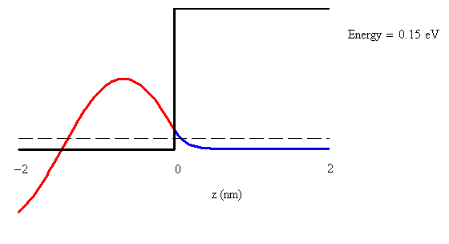
Fig. 2.4 Animation

Slide 2
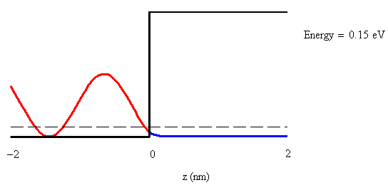
Fig. 2.5 Animation

Slide 3
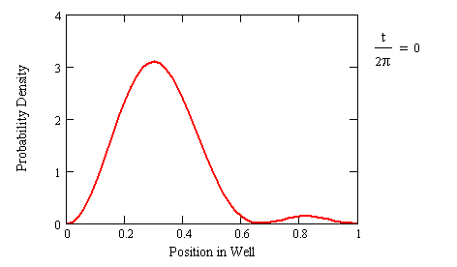
Fig. 3.1 Animation

Slide 4
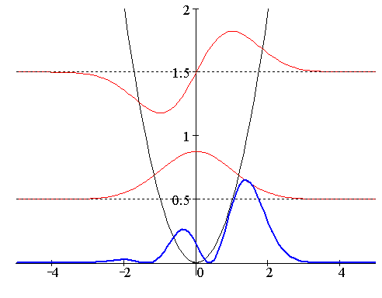
Fig. 3.2 Animation

Slide 5
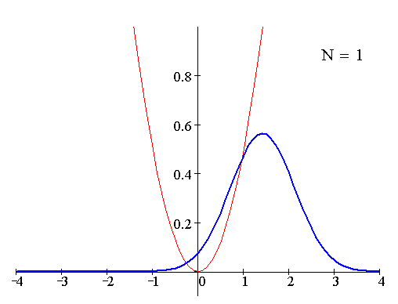
Fig. 3.3 Animation

Slide 6
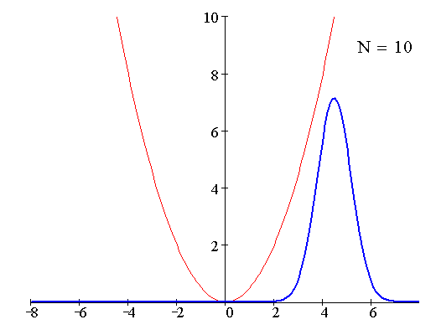
Fig. 3.4 Animation

Slide 7
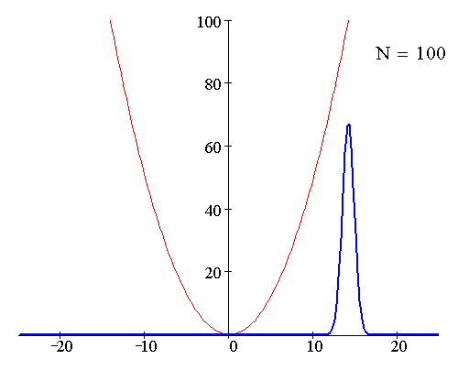
Fig. 3.5 Animation

Slide 8
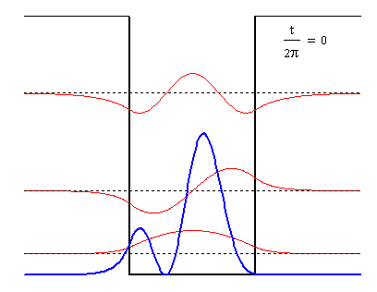
Fig. 3.6 Animation

Slide 9
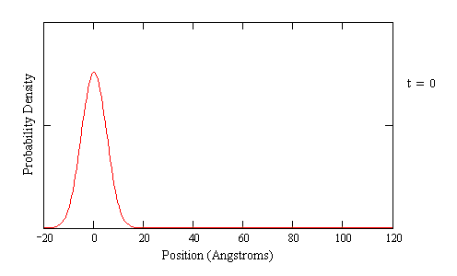
Fig. 3.8 Animation

Slide 10
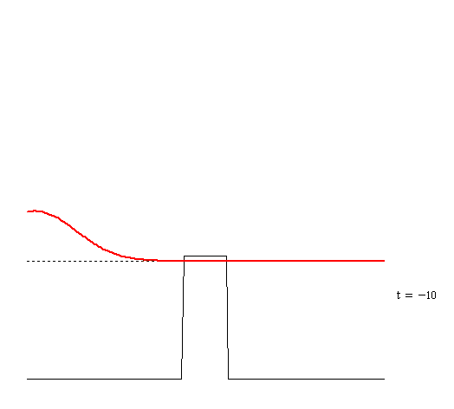
Fig. 3.9 Animation (0.953 eV energy)

Slide 11
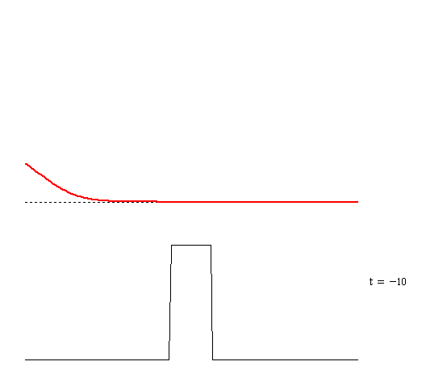
Fig. 3.9 Animation (1.372 eV energy)

Slide 12
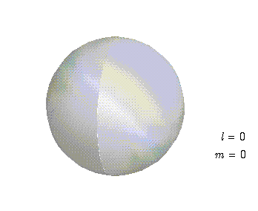
Fig. 9.3 Animation l=0, m=0

Slide 13
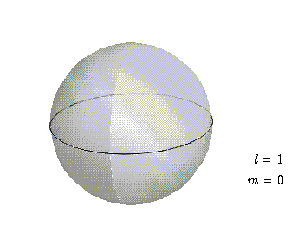
Fig. 9.3 Animation l=1, m=0

Slide 14
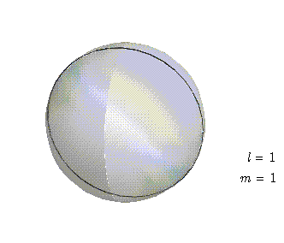
Fig. 9.3 Animation l=1, m=1

Slide 15
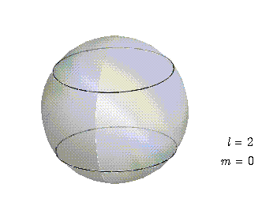
Fig. 9.3 Animation l=2, m=0

Slide 16
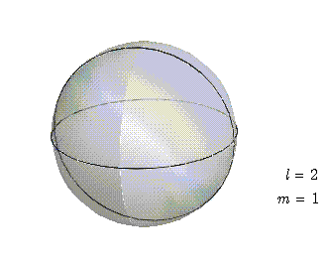
Fig. 9.3 Animation l=2, m=1

Slide 17
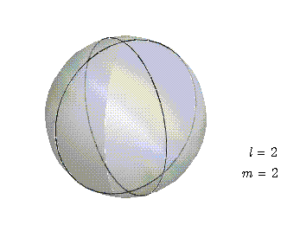
Fig. 9.3 Animation l=2, m=2

Slide 18
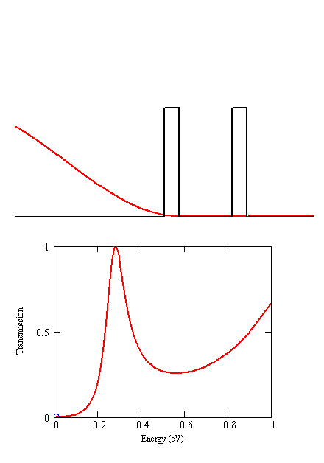
Fig. 11.5 Animation

